Slide 1
Process Capability: History, Assumptions, and Challenges
Daniel Griffith, Minitab Inc.
Eduardo Santiago, Minitab Inc.
Session M18
ASQ World Conference

Slide 2
Learning Objectives
Evaluate the assumptions for Normal Capability Analysis
Run a Non-Normal (NN) Capability Analysis using different techniques
Determine what makes data Non-Normal
Assess the weaknesses of Normality tests
Learn how to deal with data coming from a measurement system with low discrimination

Slide 3
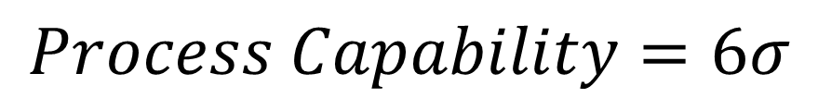
History of Capability Analysis
Popularized by J. Juran in his Quality Control Handbook [1].
Capability ratio is the tolerance width divided by the process capability, Cp.
Notes:
And inherent reproducibility refers to the product uniformity resulting from a process that is in a state of statistical control, e.g., in the absence of time-to-time drift or other assignable causes of variation.

Slide 4
History of Capability Analysis
Late 1980’s, more capability indices were formally introduced.
Kane [2] introduced Cpk.
Capability indices can be translated to a defect or quality rate.

Slide 5
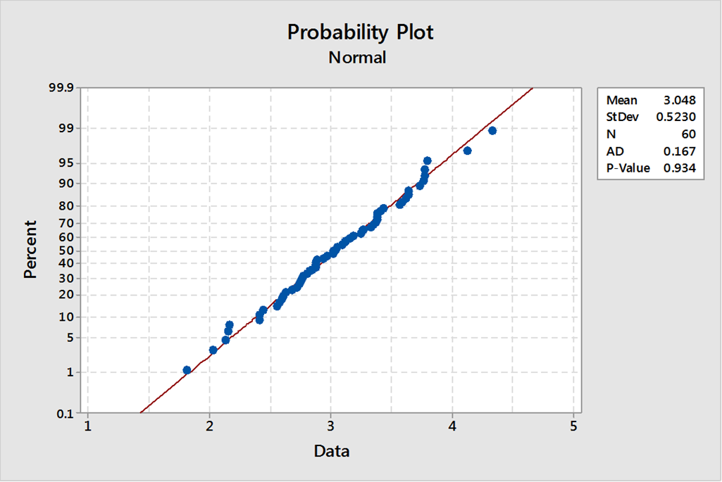
Normal Capability Analysis
Is the data normally distributed?

Slide 6
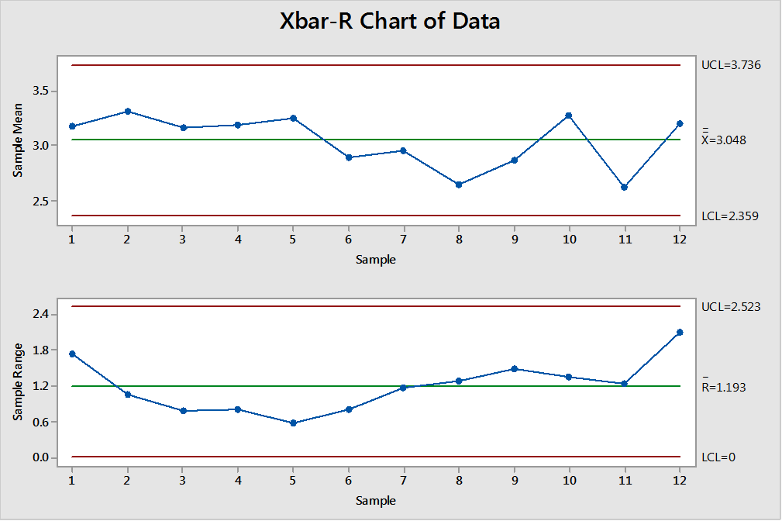
Normal Capability Analysis
Is the data normally distributed?
Is the data stable over time?

Slide 7
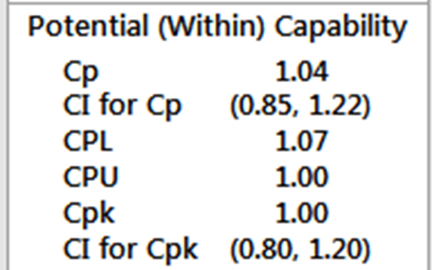
Normal Capability Analysis
Is the data normally distributed?
Is the data stable over time?
Are we confident in our conclusions?

Slide 8
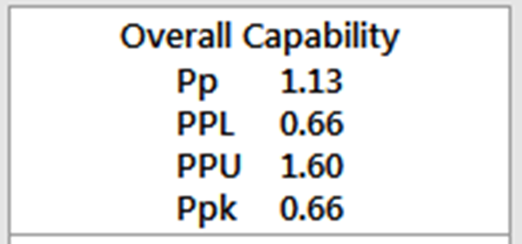
Normal Capability Analysis
Is the data normally distributed?
Is the data stable over time?
Are we confident in our conclusions?
How can we improve our process?

Slide 9
Is the Data Normally Distributed?
Why does it matter?
Let’s test how robust Capability Analysis is to Normality
We will generate data from a Weibull distribution, and see how well Normality works in this case.

Slide 10
Is the Data Normally Distributed?
7% predicted
below LSL
Ppk = 0.5

Slide 11
Is the Data Normally Distributed?
0% predicted
below LSL
Ppk = 1.36

Slide 12
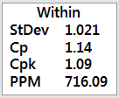
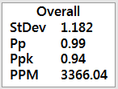
Is the Data Stable Over Time?

Slide 13
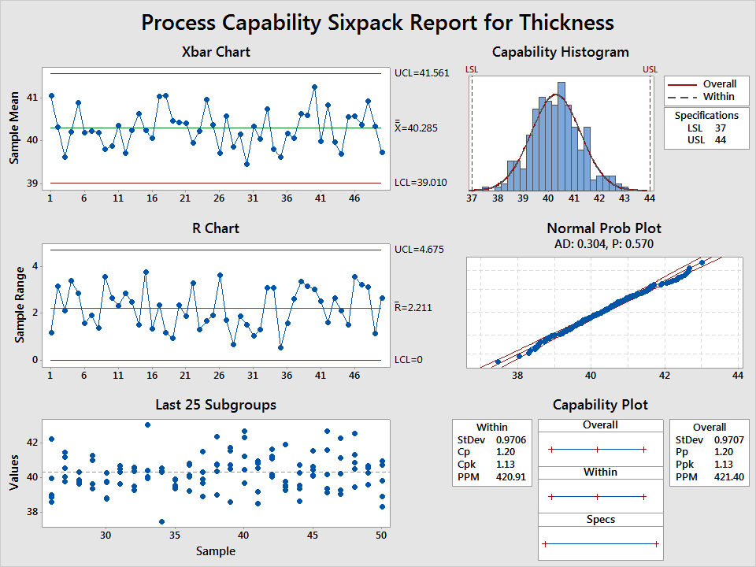
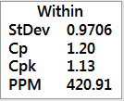
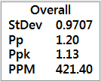
Is the Data Stable Over Time?

Slide 14
Are we confident in our conclusions?
Would I rather see this?
Or this?
Both!
Confidence Intervals provide a better understanding of how much trust we can place in our results.

Slide 15
How can we Improve our Process?
Mean = 14
StDev = 1
Pp = 1.33
Ppk = 1.33

Slide 16
How can we Improve our Process?
Mean = 17
StDev = 1
Pp = 1.33
Ppk = 0.167

Slide 17
How can we Improve our Process?
Mean = 17
StDev = 2
Pp = 0.67
Ppk = 0.083

Slide 18
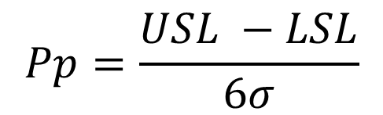
How can we Improve our Process?
So first how would we maximize Pp?
Let’s look at the formula:
Can we change the specs?
Can we change the Standard Deviation?

Slide 19
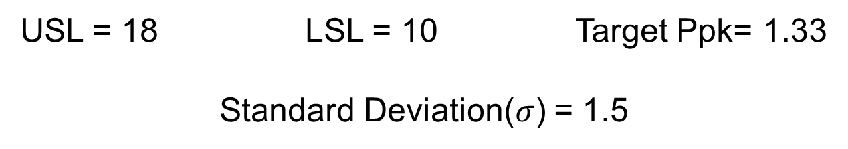
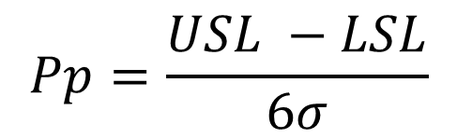


How can we Improve our Process?
Let’s throw out a scenario:
$$=\frac{18−10}{6∗1.5 }=$$
0.88
0.88

Slide 20
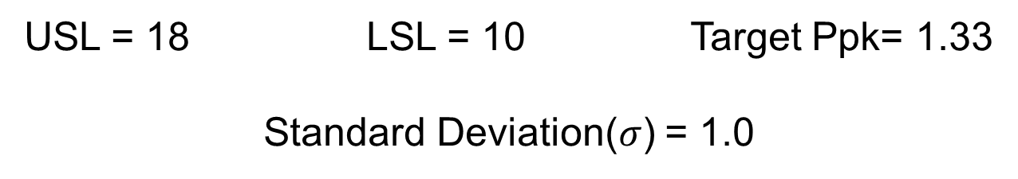


How can we Improve our Process?
Reduction of Variation by 33%
$$=\frac{18−10}{6∗1 }=$$
1.33
1.33

Slide 21
What have we learned so far? (Obj. 1)
Capability analysis is sensitive to the following assumptions.
Distribution assumption
Stability of the process
Look at confidence intervals.
To improve the capability of a process you can:
Center the mean
Reduce the variation
Re-evaluate the specs

Slide 22
What to do when Data are not Normal?
Use a transformation
Find a Non-Normal (NN) distribution to model the data
Use a nonparametric method
Options above do not apply or are not feasible, ask yourself why is the data not normal?

Slide 23
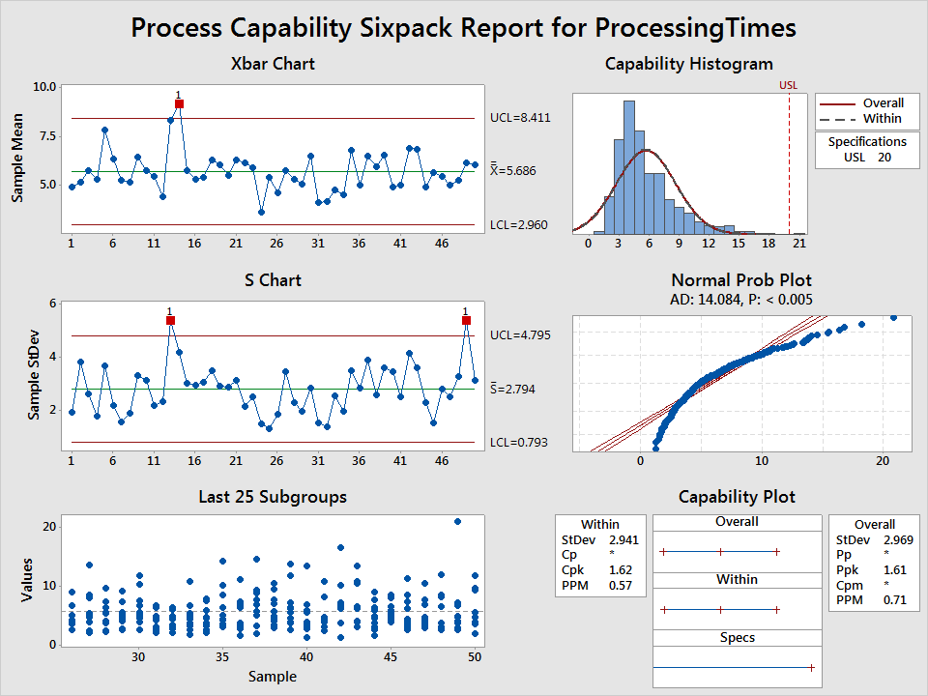
NN Capability – Transformations
Let’s analyze the processing times (min) to complete a specific task.

Slide 24
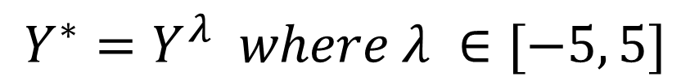
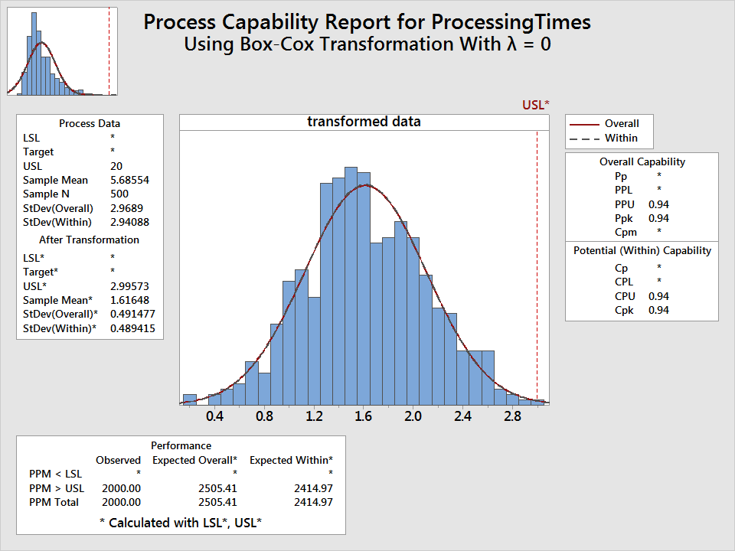
NN Capability – Transformations
The Box-Cox transformation
Note: Except when λ = 0, Y* = ln(Y)

Slide 25

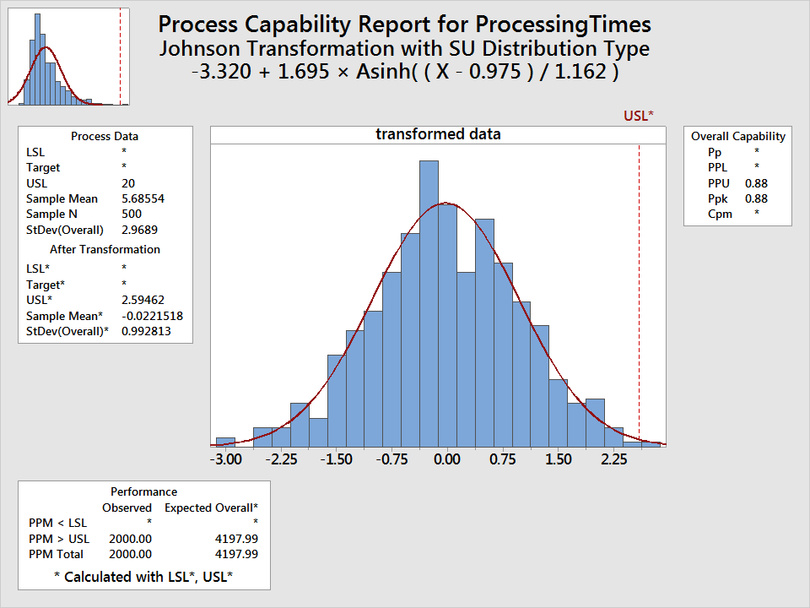
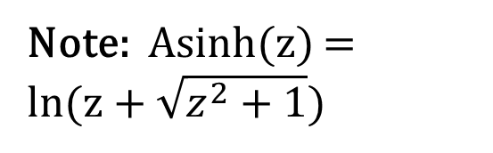
NN Capability – Transformations
The Johnson transformation

Slide 26
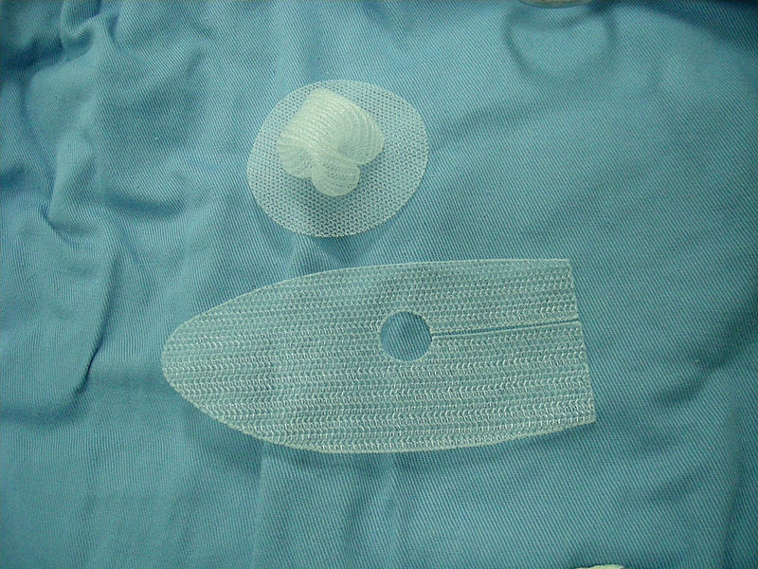
NN Capability – Alternative Distribution
Inguinal hernia surgery case study.
The company wants to assess the process capability.
LSL = 15 lbs. on a ball burst strength test.
Source: http://en.wikipedia.org/wiki/Inguinal_hernia_surgery

Slide 27
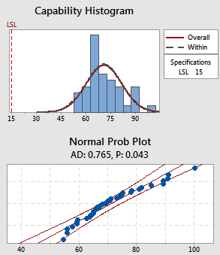
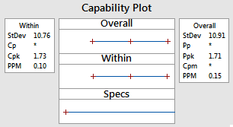
NN Capability – Alternative Distribution
Underlying data is not normally distributed.
Capability estimates are invalid.

Slide 28
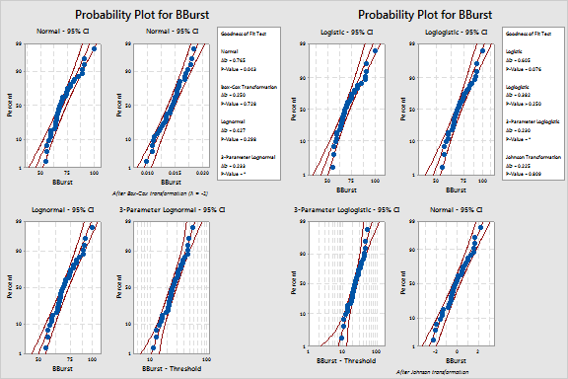
NN Capability – Alternative Distribution

Slide 29
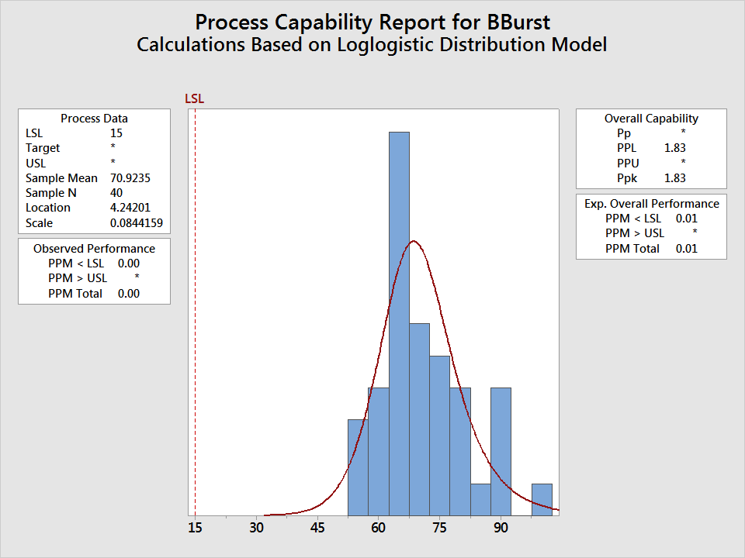
NN Capability – Alternative Distribution
Select the Loglogistic distribution to fit the data and estimate the capability of the process.

Slide 30
NN Capability – Nonparametric
Use a nonparametric method to estimate the capability of the process
See McCormack et al. [3], larger sample sizes required
Treat the data as binary and perform a test for proportion

Slide 31
NN Capability – Nonparametric
Example. A process measuring the wet weight of a product has to validate the process is capable.
Test and CI for One Proportion: Pass or Fail
Event = P
Variable X N Sample p 95% Lower Bound
Pass or Fail 7967 7978 0.998621 0.997719

Slide 32
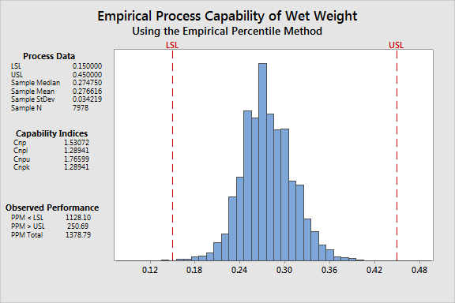
NN Capability – Nonparametric
Wet weight analysis using nonparametric capability.

Slide 33
What have we learned? (Obj. 2)
When data are Non-Normal, multiple techniques can be utilized:
Use a Johnson or Box-Cox transformation
Model the data with a Non-Normal distribution, e.g. Weibull, Lognormal, Smallest Extreme Value
With large sample sizes you can utilize nonparametric approaches
If no approach works for your specific situation, investigate what makes data Non-Normal. How?

Slide 34
Why are the Data not Normal?
Case I. Nature of the beast – process near a boundary, naturally produces data that are skewed.
Case II. Mixture of distributions or a few outliers – process may not be in statistical control.

Slide 35
Why are the Data not Normal?
Case III. Large sample sizes – power of normality tests detects small departures from “perfect” normality.
Case IV. The number of significant digits is not sufficient to differentiate between parts, rendering the classic normality tests ineffective.

Slide 36
Normality Test Failed – Case I
This scenario is typically straightforward, the selection of a non-normal distribution is typically done using a distribution identification tool or scientific knowledge about what distribution models a specific situation.

Slide 37
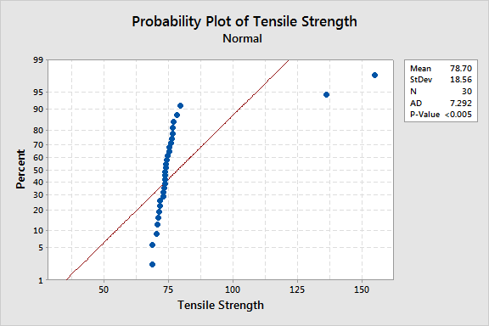
Normality Test Failed – Case II
The sample obtained to estimate the capability of a process can include data from different distributions.

Slide 38
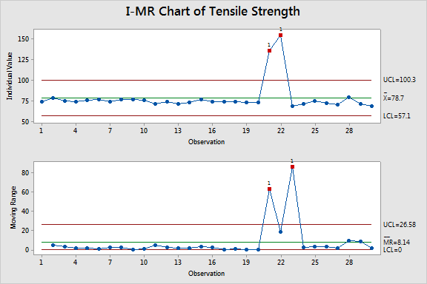
Normality Test Failed – Case II
Detection of multiple distributions can be done with a control chart.

Slide 39
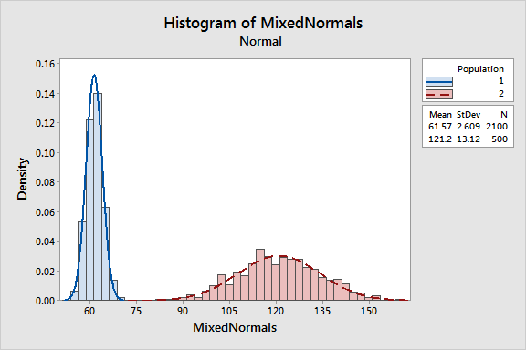
Normality Test Failed – Case II
What to do in a situation like this?
Better control of the process. Implement corrective and preventive actions.

Slide 40
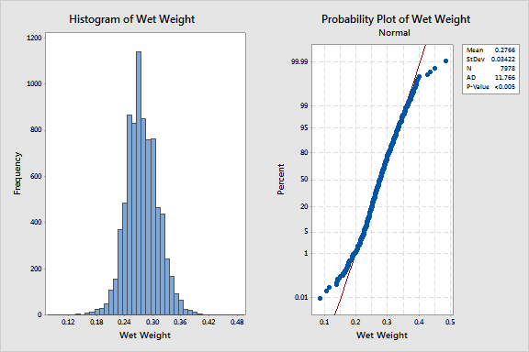
Normality Test Failed – Case III
Revisit the “Wet Weight” example with over 7,000 observations. Data looks normal.

Slide 41
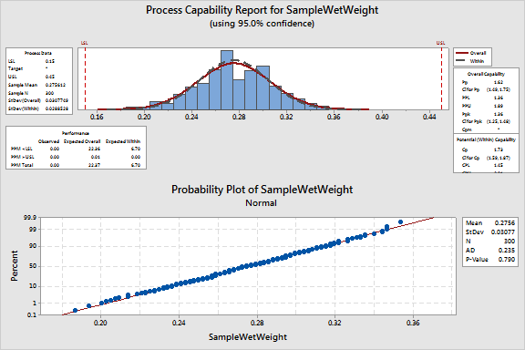
Normality Test Failed – Case III
What is the issue?
To quote G.E.P. Box in a slight different context: “All models are wrong, but some of them are useful.”
Easy solution: Use a nonparametric approach or get a random sample from your data.

Slide 42
Normality Test Failed – Case III
Comparing the capability estimates for the overall defect level for all analyses done on this dataset.
Method | Cpk | Defect rate | Yield
One proportion | N/A | 0.14% | 99.86%
Nonparametric percentile method | 1.29* | 0.14% | 99.86%
Normal method | 1.45 | 0.0022% | 99.9978%

Slide 43
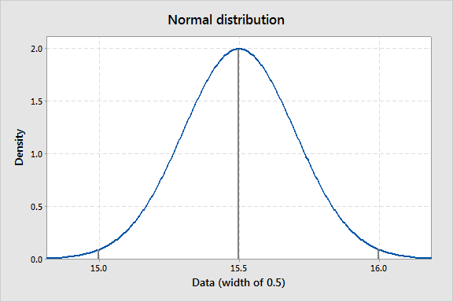
Normality Test Failed – Case IV
Low discrimination of the measurement system.
Rounding and low discrimination between parts generates only three likely values: 15, 15.5, 16.

Slide 44
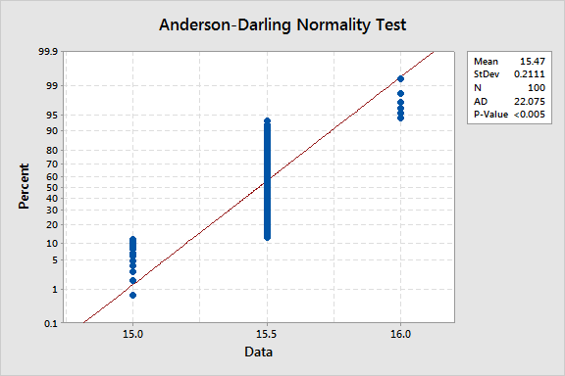
Normality Test Failed – Case IV
Ties lead to the Anderson-Darling (AD) test failing normality.

Slide 45
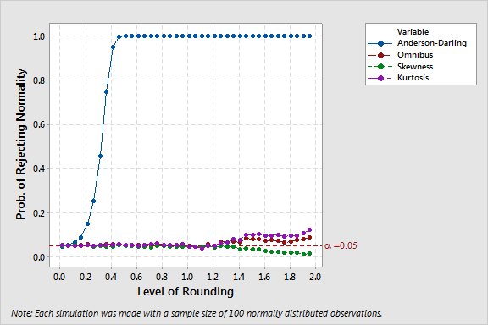
Normality Test Failed – Case IV
For heavily rounded datasets the Skewness (SK), Kurtosis (KT), Omnibus (OB) tests may be preferred.
At each point, we generated 5000 normal samples of N=100 and subject each sample to four Normality tests.

Slide 46
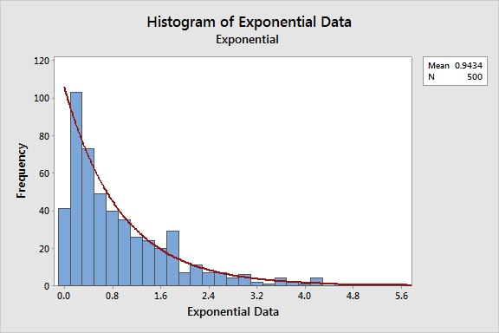
Normality Test Failed – Case IV
Let’s consider now a highly skewed distribution, namely the exponential distribution.

Slide 47
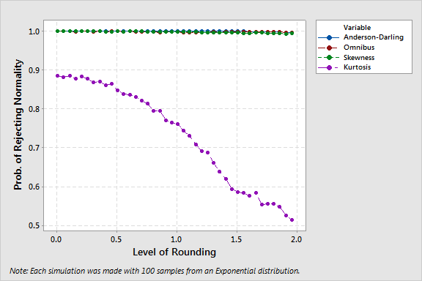
Normality Test Failed – Case IV
The AD seems to perform as well as the OB and SK tests, but its detection of non-normal data comes as a consequence of rounding.
At each point, we generated 5000 samples of 100 observations each from an Exponential(Mean=1).

Slide 48
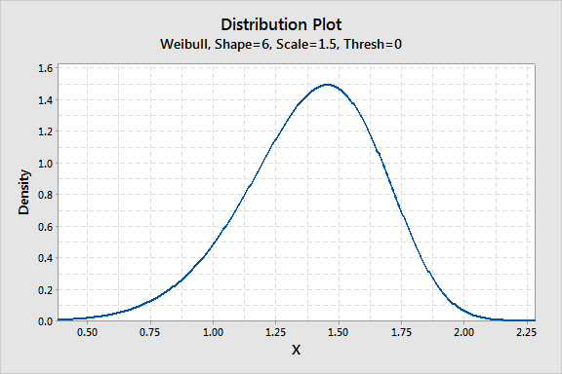
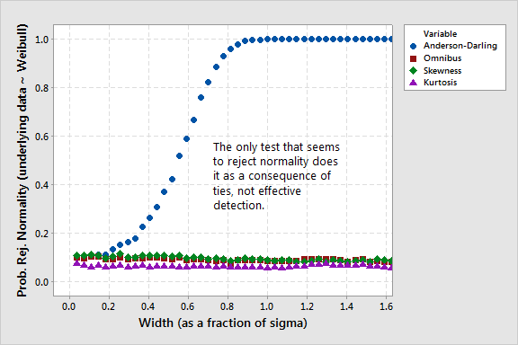
Normality Test Failed – Case IV
What if the data is not severely skewed but still not normally distributed?

Slide 49
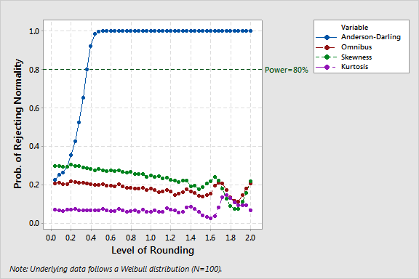
Normality Test Failed – Case IV
The only test that seems to consistently reject normality (AD) does it as a consequence of ties, not effective detection.

Slide 50
What Normality Test to Use?
Skewness fails to reject normality at the expected α level when the data are normal.
Skewness has good power and is less sensitive to the degree of rounding.
The Omnibus and Skewness tests have similar behavior.

Slide 51
What have we learned? (Obj. 3, 4)
The nature of the data can make the use of the normal distribution inappropriate.
Lack of controls in a process can produce samples that mix data from different distributions.
Large sample sizes can make normality tests too sensitive.
As the level of rounding increases, classic normality tests become less effective.

Slide 52
Capability with Rounded Data
There a few approaches to estimate the capability of a process:
Classic approach
Adjust the estimates considering the bias induced by the measurement system
Handle the data as being interval-censored

Slide 53
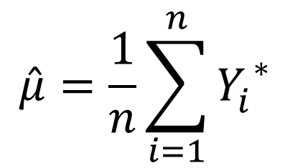
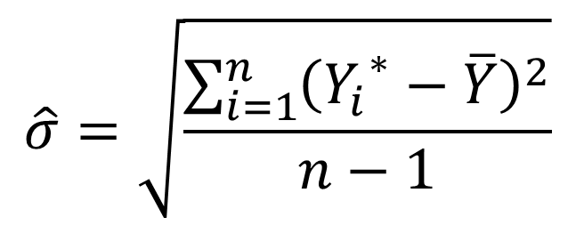
Classic Capability Estimates
The rounded data, denoted Y*, is assumed to be normally distributed:
Proceed to estimate Cpk as usual.

Slide 54
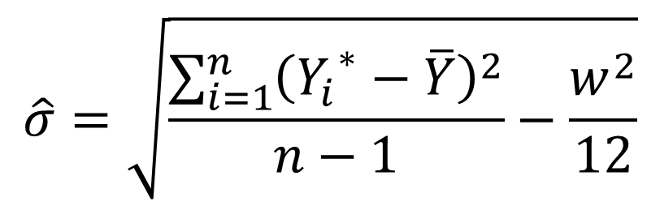
Adj. Estimates – Sheppard’s Correction
Sheppard [5] describes the bias in the estimation of the standard deviation when the data is rounded.
where w is the width (incremental unit) of the measurement system.

Slide 55
Estimates from Interval-Censored Data
Suppose we don’t know the exact value that corresponds to the true measurement but we know the interval in which it must be.
Observed Values
5.1
5.1
5.0
5.2
5.1
5.0
Start | End | Frequency
4.95 | 5.05 | 2
5.05 | 5.15 | 3
5.15 | 5.25 | 1
Converted to

Slide 56
Estimates from Interval-Censored Data
We get the following estimates:
Variable Start: Start End: End
Frequency: Frequency
Censoring Information Count
Interval censored value 6
Estimation Method: Maximum Likelihood (MLE)
Distribution: Normal
Parameter Estimates
Standard 95.0% Normal CI
Parameter Estimate Error Lower Upper
Mean 5.08345 0.0278668 5.02883 5.13807
StDev 0.0619204 0.0218490 0.0310086 0.123648

Slide 57
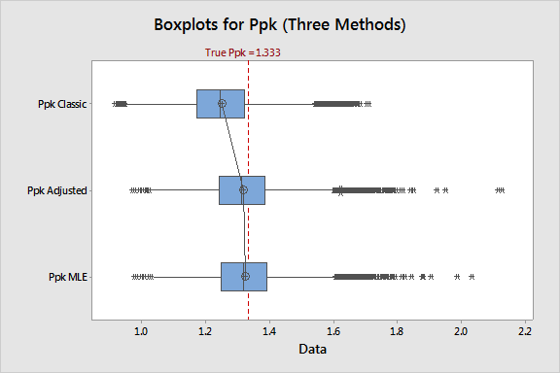
Capability with Rounded Data

Slide 58
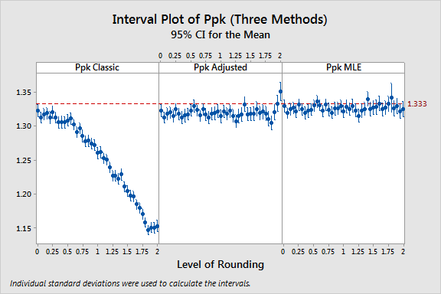
Capability with Rounded Data

Slide 59
What was the last lesson? (Obj. 5)
Rounded data makes classic normality tests fail. [They reject all the time no matter what type of data you have]
Rounded normal data should be symmetric, thus making skewness and omnibus tests extremely useful.
Other issues in the data may not be captured by these tests.

Slide 60
What was the last lesson? (Obj. 5)
Using interval-censored data with Maximum Likelihood Estimates (MLEs) seem to produce better estimates across the board.
MLEs are asymptotically unbiased. [As the sample size grows larger, the bias of the estimates becomes negligible]
The simplicity of Sheppard’s adjustment to estimate σ makes it compelling too.

Slide 61
Conclusions
The ultimate goal of a capability analysis is to estimate the defective level of a process.
When the interest of an analysis is on the estimation of defects, the distribution assumption will be an important one.
Another important assumption is ensuring the process is stable and in control.

Slide 62
Conclusions
Of the two assumptions, normality is the one typically violated in practice.
Non-normal (NN) capability analysis requires:
Using a transformation
Finding an alternative distribution that fits the data
Using a nonparametric approach which requires a large sample size

Slide 63
Conclusions
Classic normality tests (AD, KS, SW) typically reject normality when the data is heavily-rounded regardless of the underlying distribution.
When using a gauge with low discrimination, use different tests to check for normality, e.g. Skewness or the Omnibus test.

Slide 64
Conclusions
If no evidence exists of the rounded data not being normal, assume normality.
Utilize interval-censoring (MLE) to estimate the mean and standard deviation.

Slide 65
References
Juran, J.M., Godfrey, A.M. “Juran’s Quality Handbook”. 5th edition, McGraw-Hill. New York, 1999.
Kane, V.E. (1986) “Process Capability Indices”. Journal of Quality Technology, 18, 41-52.
McComack, D.W., Harris, I.R., Hurwitz, A.M., and Spagon, P.D. (2000) “Capability Indices for Non-normal data”, Quality Engineering. 12(4), 489-495.
Schneeweiss, H., Komlos, J., and Ahmad, A.S. (2006) “Symmetric and Assymetric Rounding.” Working paper.
Sheppard, W.F. (1898). “On the calculation of the most probable values of frequency constants for data arranged according to equidistant division of a scale.” Proceedings of the London Mathematical Society. 29, 231-258.
Tricker, A.R. (1984) “Effects of Rounding on the Moments of a Probability Distribution.” Journal of the Royal Statistical Society. Series D (The Statistician). 33(4), 381-390.

Slide 67
ADDITIONAL SLIDES

Slide 68
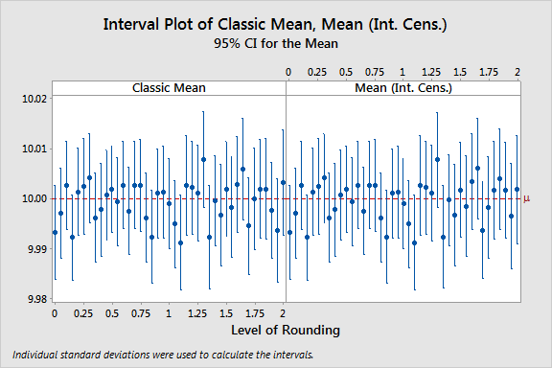
Capability with Rounded Data (N=100)

Slide 69
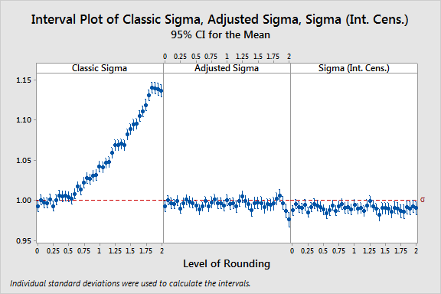
Capability with Rounded Data (N=100)

Slide 70
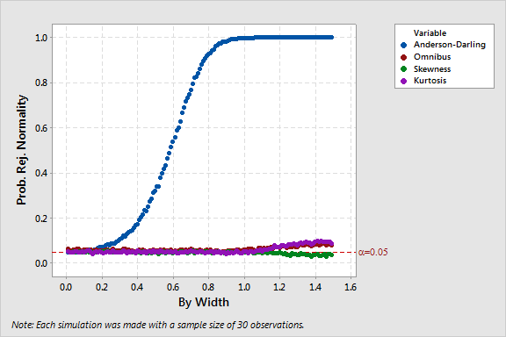
Normality tests for Normal data (N=30)

Slide 71
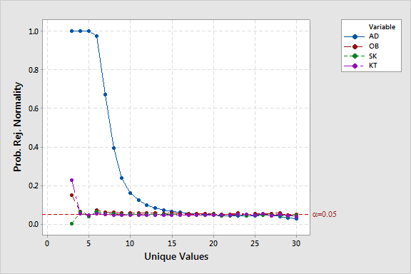
Normality tests performance (Ties)
Starting with four unique values, the OB, SK, and KT tests performed as expected. These three tests are robust to the number of unique values, unlike the Anderson-Darling, Kolmogorov-Smirnov, or Shapiro-Wilk tests.

Slide 72
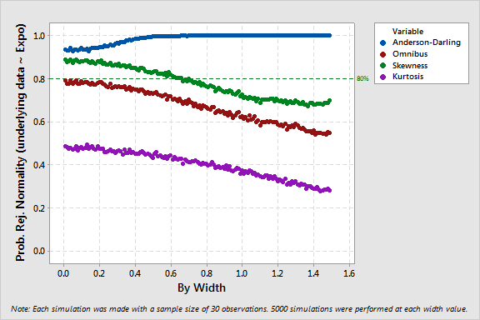
Normality tests for Expo data (N=30)

Slide 73

Normality tests performance (Expo)
None of the tests would performed as desired. Makes sense since data is approximately symmetric and bell-shaped.

Slide 74

Normality tests for Weibull data (N=30)

Slide 75

Normality tests performance (Weibull)

Slide 76

Comparison of Classic Normality Tests

Slide 77
Case Study
A medical device manufacturer builds a blood glucose measurement apparatus for diabetics to use at home. The reading has to be truncated so that it is easy for the customer to read and understand. They measure a standard solution on 100 devices to set a baseline. The specs are [99, 136].

Slide 78
Data
122
118
117
120
120
121
122
116
124
117
121
120
118
117
120
118
119
122
121
118
119
118
119
119
120
117
121
120
118
122
119
120
120
121
122
118
118
117
119
121
123
117
118
120
118
122
118
124
118
121
116
116
118
121
120
119
119
117
121
121
119
120
120
118
117
120
118
120
119
121
120
118
119
117
119
120
121
121
118
119
119
121
120
119
121
120
119
120
122
118
121
120
123
118
117
118
120
115
121
119

Slide 79


Case Study
Classic Normality tests fail.

Slide 80
Case Study
Try an alternative normality test instead, such as the Skewness test.
Total number of observations in Glucose = 100
Data Display
Z 0.600407
P-value 0.548235

Slide 81
Case Study
Convert the data to the following format.
Start End Frequency
114.5 115.5 1
115.5 116.5 3
116.5 117.5 10
117.5 118.5 20
118.5 119.5 17
119.5 120.5 21
120.5 121.5 17
121.5 122.5 7
122.5 123.5 2
123.5 124.5 2

Slide 82

Case Study
Treat the data as interval-censored and analyze it with Parametric Distribution Analysis to get the estimates of μ and σ.

Slide 83

Case Study
Finally, with the estimates of 119.41 for the mean and 1.766 for the standard deviation proceed to estimate Ppk as usual.
$$Ppk=min\left[\frac{USL−\hat{μ}}{3\hat{σ}},\frac{\hat{μ}−LSL}{3\hat{σ}}\right]=3.13$$

